Slide 1

STUDENT SELF-ASSESSMENT SYSTEM
Batch No: A-15 Project Guide:
Anusha B R (174g1a0509) Mr. M.Narasimhulu M.Tech,(Ph.D)
Haritha D (184g5a0502) Assistant Professor`
Sai Pavan B (174g1a0559)
Lakshmi Narasimhulu P (184g5a0503)
Srinivasa Ramanujan Institute of Technology
Department of Computer Science & Engineering

Slide 2
Abstract
Web technologies are the various tools and techniques that are utilized in the process of communication between different types of devices over the internet. It is an ocean comprising hundreds of languages and frameworks that are used to develop the frontend and backend of the web application efficiently to enable smooth user interaction and to enhance server responsiveness.
The aim of our project is to develop a system that keeps track of all the academic activities of a student and provides insights to aid the student’s progress. It does this by suggesting the areas of improvement, by analyzing the student’s performance and displaying the results, and by providing an option to share the student’s profile with others for their feedback..

Slide 3
Contents
Introduction
Existing and proposed system
Software requirements
Problem definition and solution
Django Architecture Diagram
Use case diagram of the application
Sections of the web application

Slide 4
Introduction
A student has to go through a lot of exams and scrutiny in his/her educational period to promote themselves to higher levels.
In this journey, one often gets lost not knowing where one stands as per the academics and what steps one has to take for climbing up the academic ladder.
Our project – The student self-assessment system helps students to do just that by tracking the progress and providing necessary suggestions.

Slide 5
Existing and Proposed System
Existing System:
In educational institutions, especially those for adults, students are often required to take examinations frequently until the completion of their course to assess their knowledge. As often as it is, the conventional approach does not motive students enough and sometimes fails to let them know their capabilities.
Proposed System:
Student self-assessment system provides a platform for students to set attainable targets as to how much they aim to score in their academics in a particular semester and by the end of their course. The system keeps track of their activities and generates a report which allows students to know whether they are in the track and what average they should maintain to attain their final goal. It also visualizes their progress in various academic areas.

Slide 6
Software Requirements
The Software requirements for the development of our web application are:
Python Django
React JS
HTML
Javascript
Bootstrap
Visual Studio Code

Slide 7
Problem definition and solution
Problem definition:
A student as he grows into an adult is expected to learn things by himself and he is not frequently guided by teachers or parents as it happens with children, but due to many factors students often fail to have a proper introspection of themselves.
Solution:
To sharpen their introspection skills and cognitive abilities, all students need is useful and concise information about themselves which they can use to make useful decisions to excel in their academics. Student self assessment system provides crisp information about their performance to alert them about the same.

Slide 8
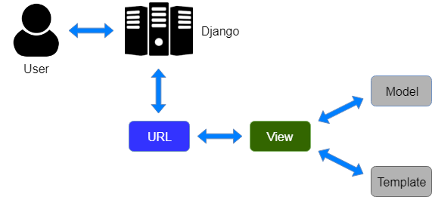
Process flow in Django MVT Architecture

Slide 9
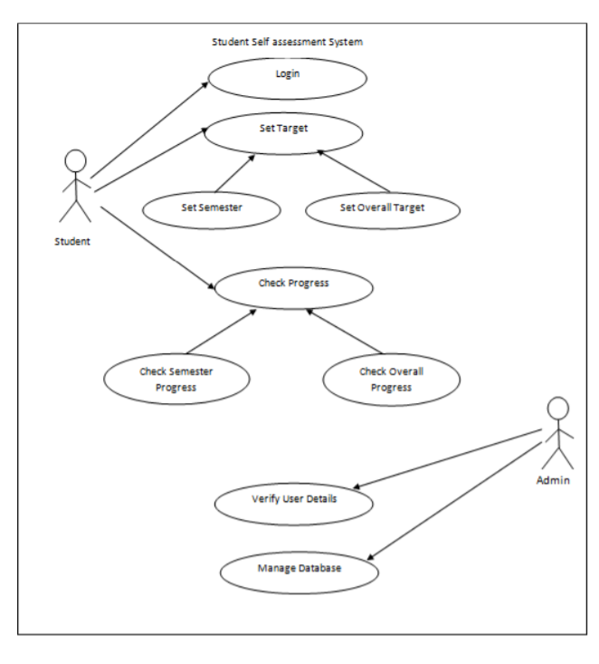
Use case of the application

Slide 10
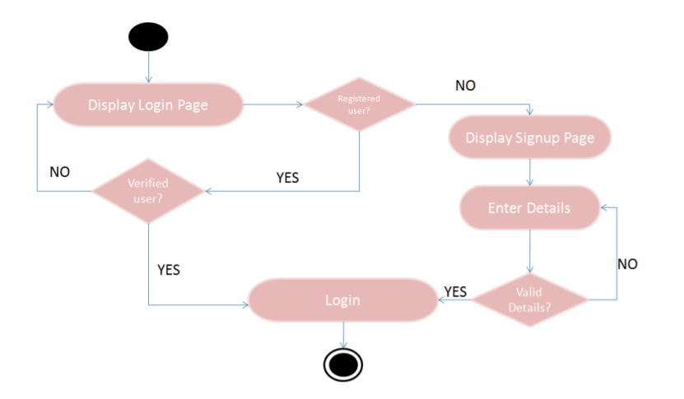
Activity Diagram of the Login Page

Slide 11
Sections of the web application
The web application comprises of the following main sections:
Index section
Signup/ Login section
Home section
Progress section
Report & suggestions section

Slide 12
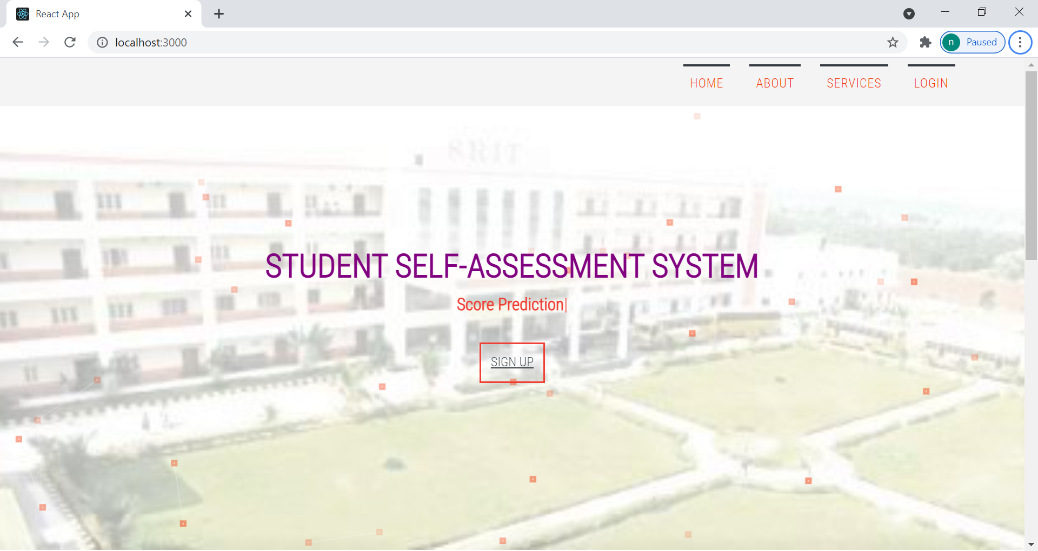
Index Page

Slide 13
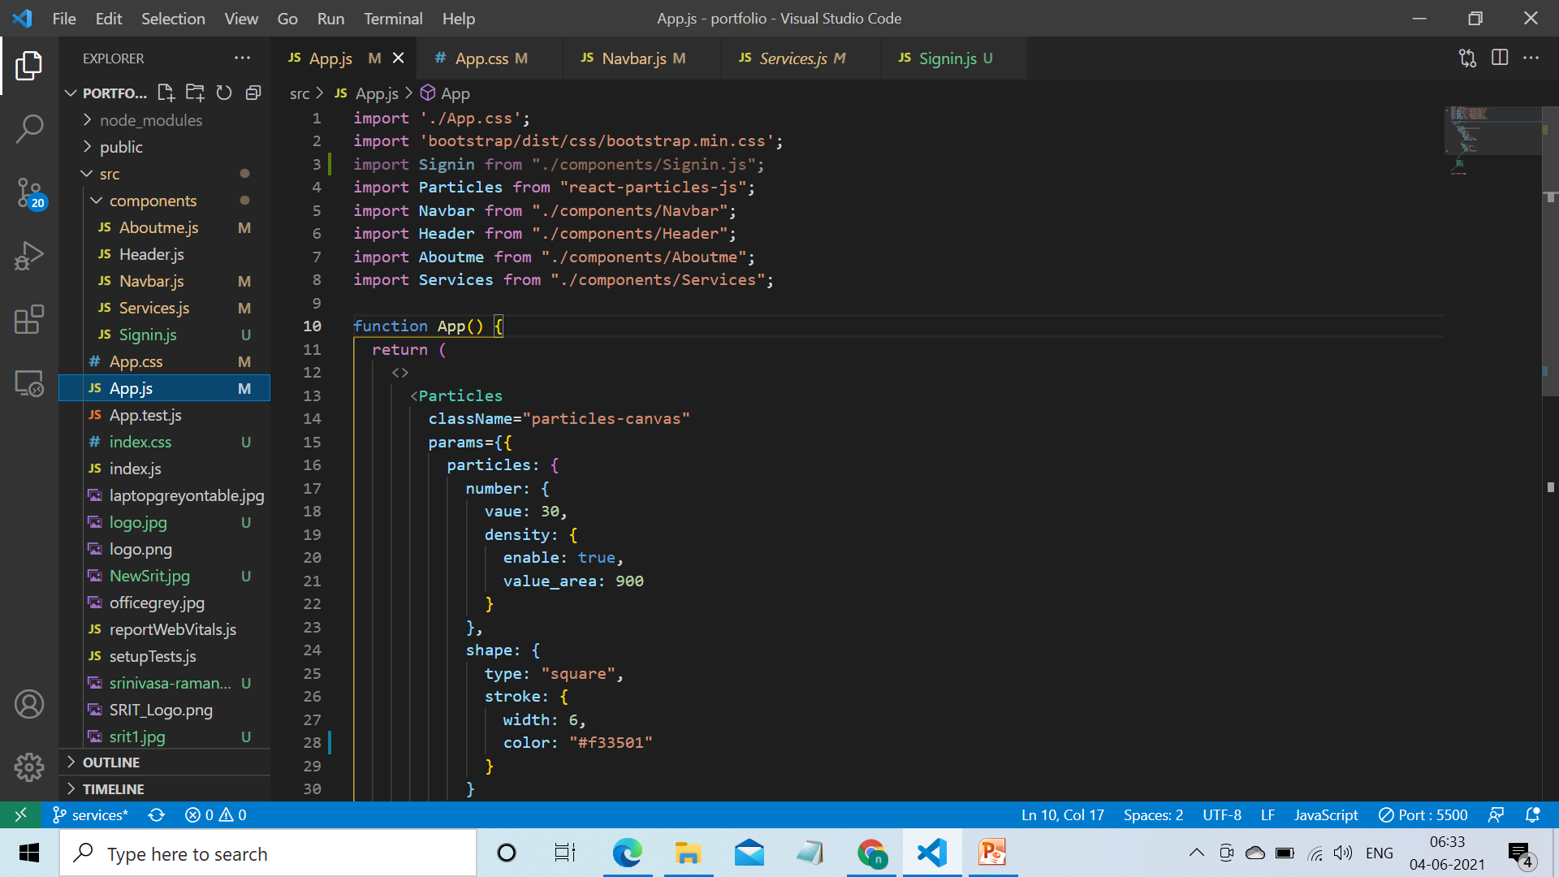
Code for the Index Page

Slide 14
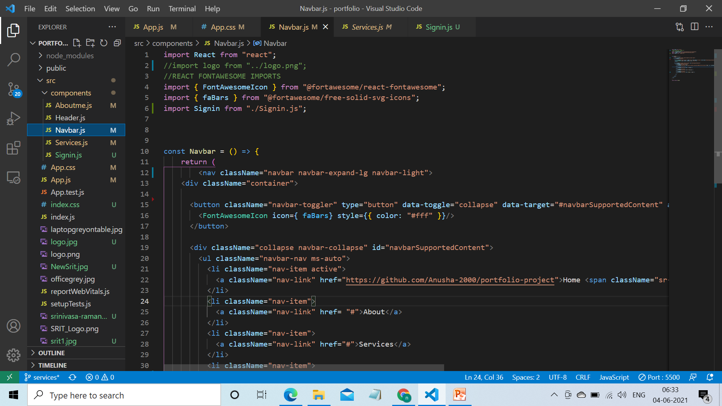
Code for the Index Page

Slide 15
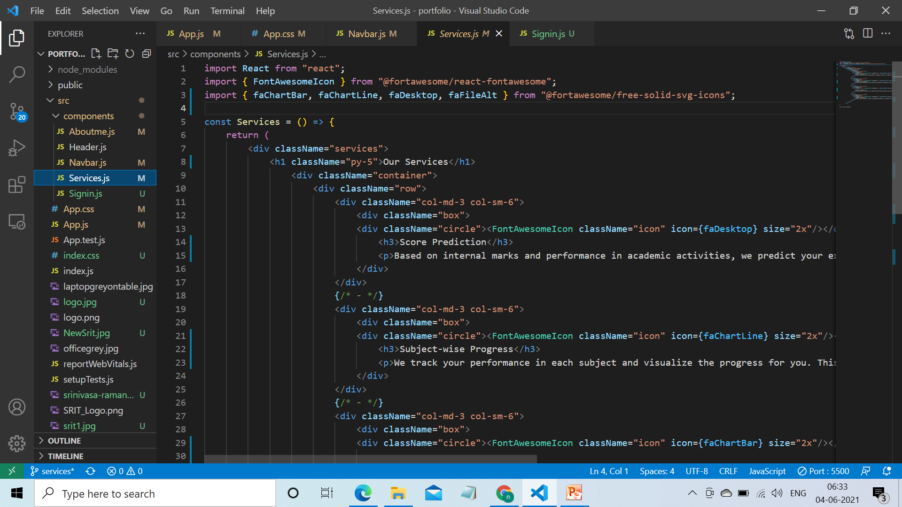
Code for the Index Page

Slide 16
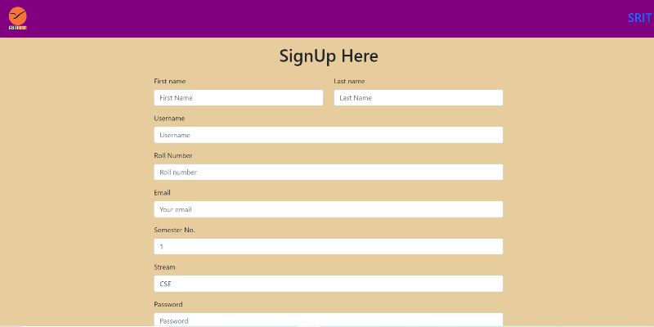
Signup Page

Slide 17
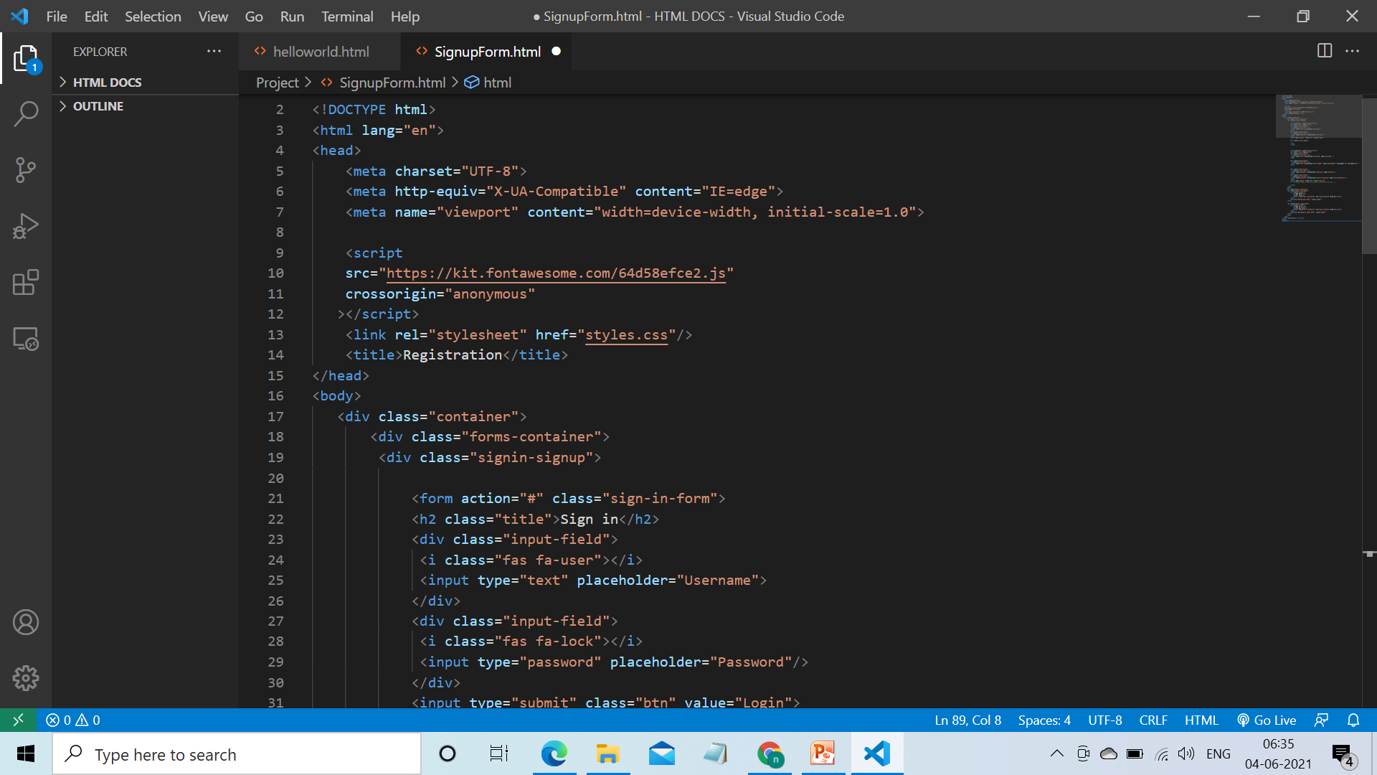
Code for the Signup Page

Slide 18
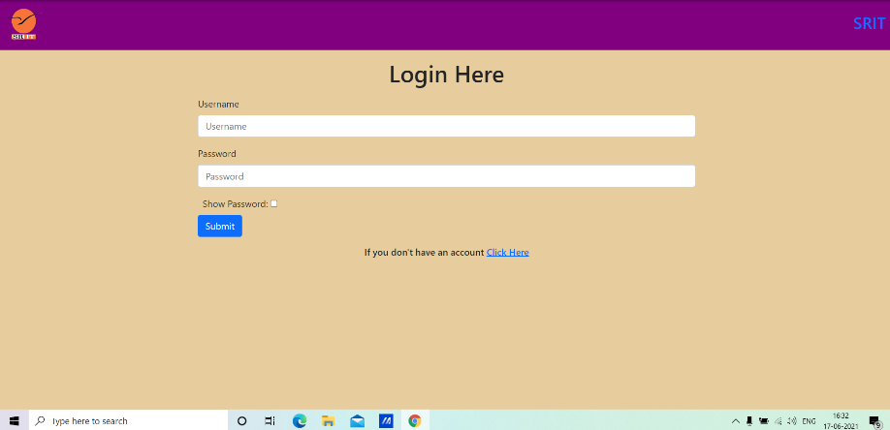
Login Page

Slide 19
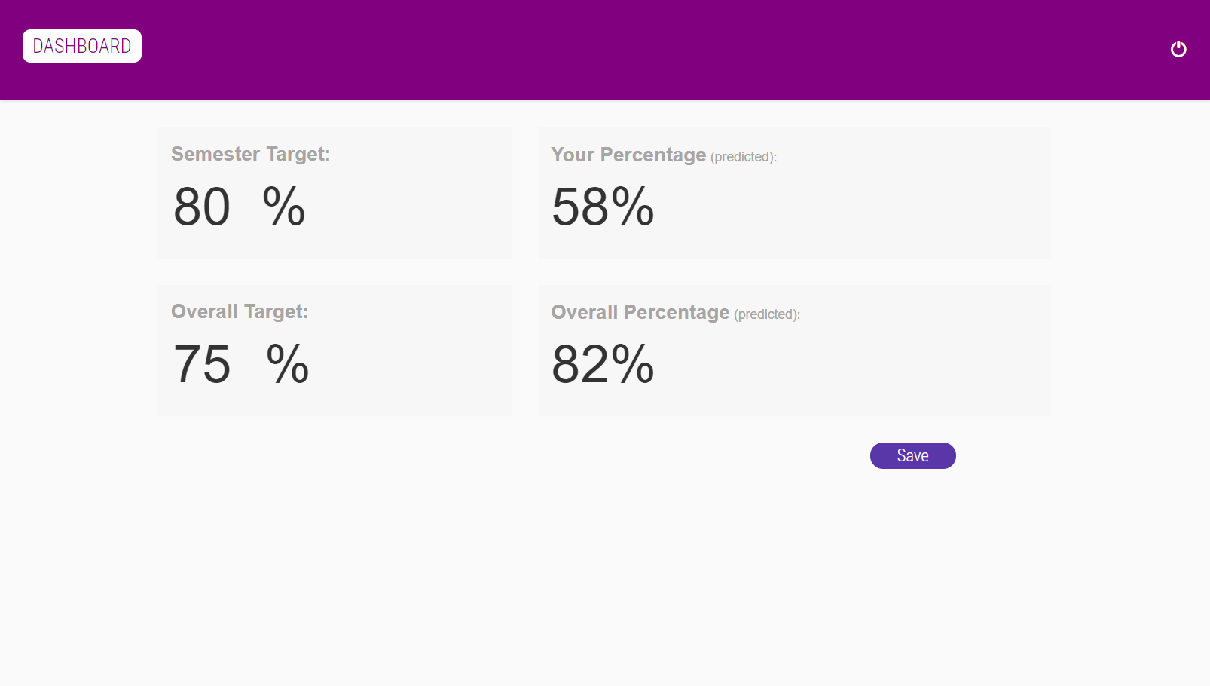
Home page

Slide 20
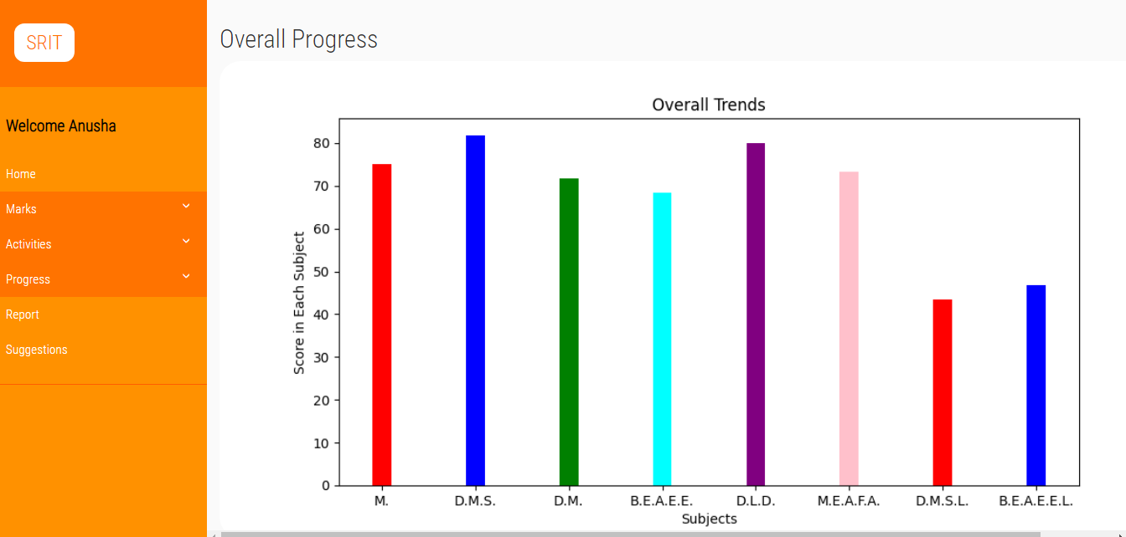
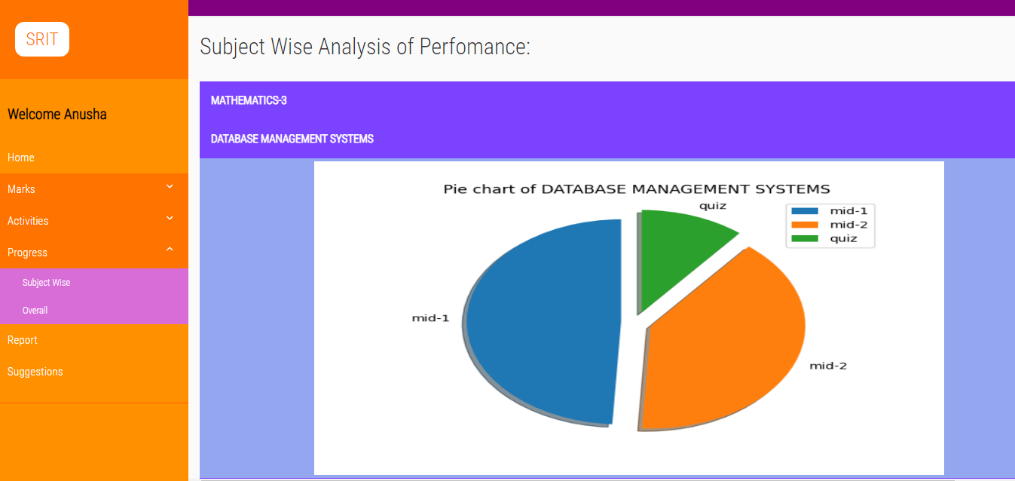
Progress page

Slide 21
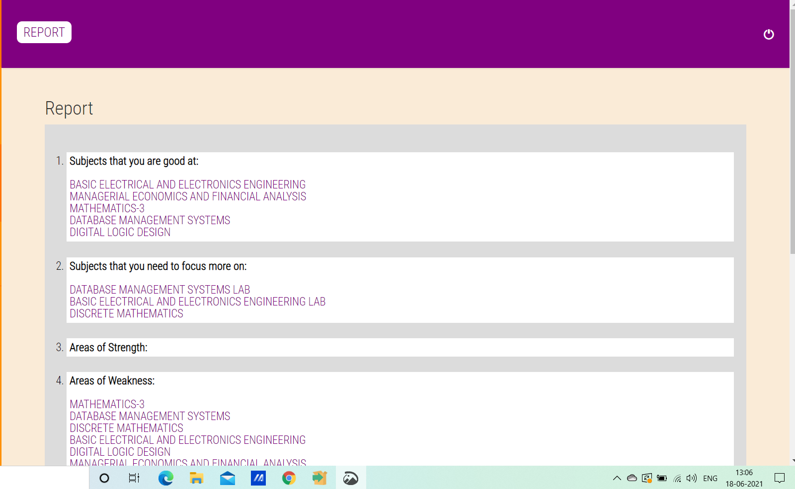
Report page

Slide 22
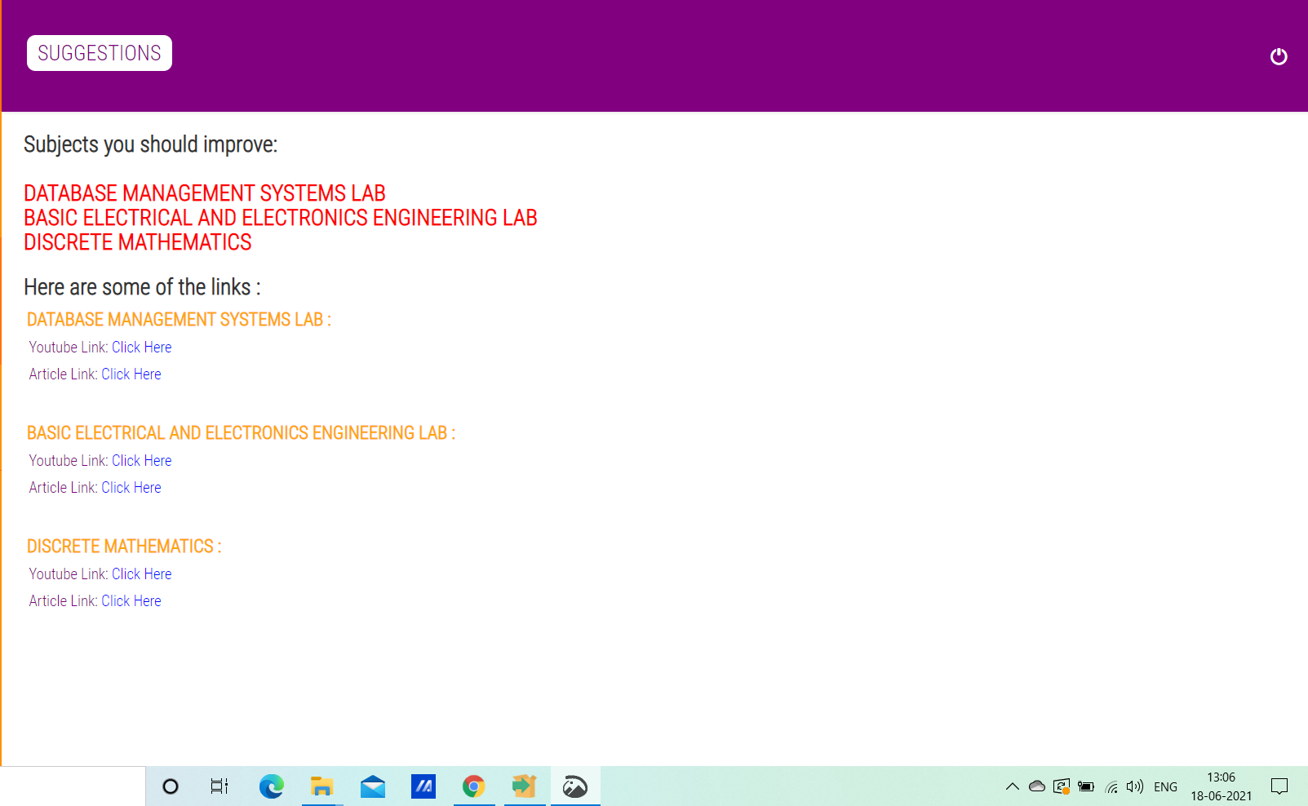
Suggestions page

Slide 23
Conclusion:
Self-assessment is feedback (Andrade, 2010), and that the purpose of feedback is to inform adjustments to processes and products that deepen learning and enhance performance.[1]
The purpose of self-assessment is to generate feedback that promotes learning and improvements in performance. This learning-oriented purpose of self-assessment implies that it should be formative: if there is no opportunity for adjustment and correction, self-assessment is almost pointless. [1]
You can create an application in which you feed your input data and it predicts the output for you using your ML model. The machine learning models that you create can be put to better use if you can integrate your models into an application.[2]

Slide 24
References:
We resorted to the following articles to know about the self assessment system and what tools can be used to implement the whole idea behind it.
Articles about Self-assessment and it’s benefits:
[1] Heidi L. Andrade, “A Critical Review of Research on Student Self-Assessment”, 27 August 2019.
https://www.frontiersin.org/articles/10.3389/feduc.2019.00087/full
[2] James H. McMillan and Jessica Hearn, “Student Self-Assessment: The Key to Stronger Student Motivation and Higher Achievement”, educational HORIZONS, no. 10, pp. 40 – 49, Fall 2008.
https://files.eric.ed.gov/fulltext/EJ815370.pdf

Slide 25
Continued…
Articles about software requirements that support our system:
[3] To know how to create a web application with Django, visit: https://docs.djangoproject.com/en/3.2/
[4] To know about data visualization on a web application with python , visit:
https://www.analyticsvidhya.com/blog/2021/02/an-intuitive-guide-to-visualization-in-python/

Slide 26
Thank you
Queries
?

